Slide 1
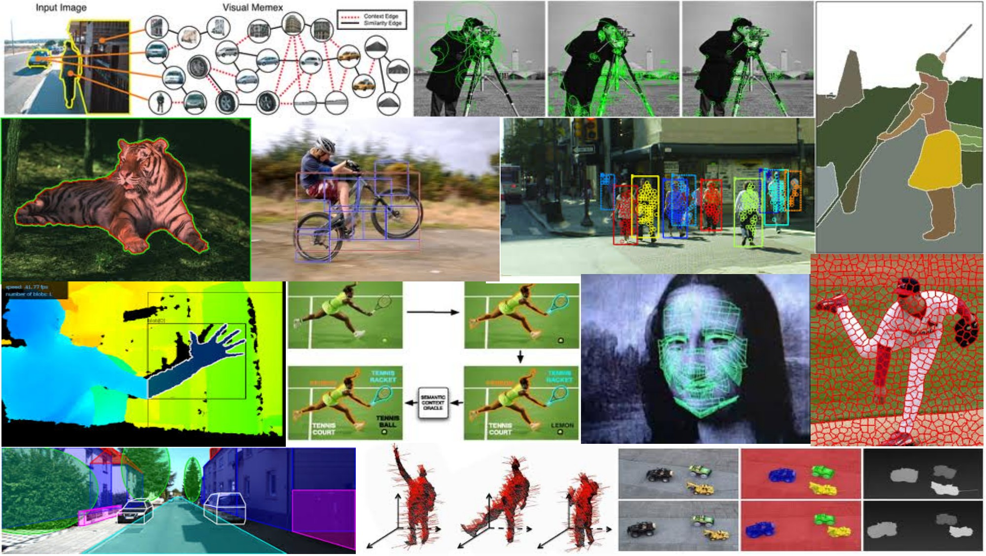
ECS 174: Computer Vision April 3rd, 2018
Yong Jae Lee
Assistant Professor
CS, UC Davis

Slide 2
Plan for today
Topic overview
Introductions
Course overview:
Logistics and requirements
Notes:
Please interrupt at any time with questions or comments

Slide 3
What is Computer Vision?

Slide 4
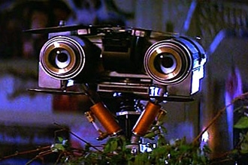
Computer Vision
Enable machines to “see” the visual world as we do

Slide 5
Computer Vision
Automatic understanding of images and video
Computing properties of the 3D world from visual data (measurement)
Notes:
5

Slide 6
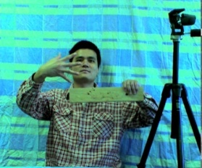
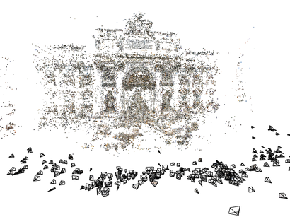
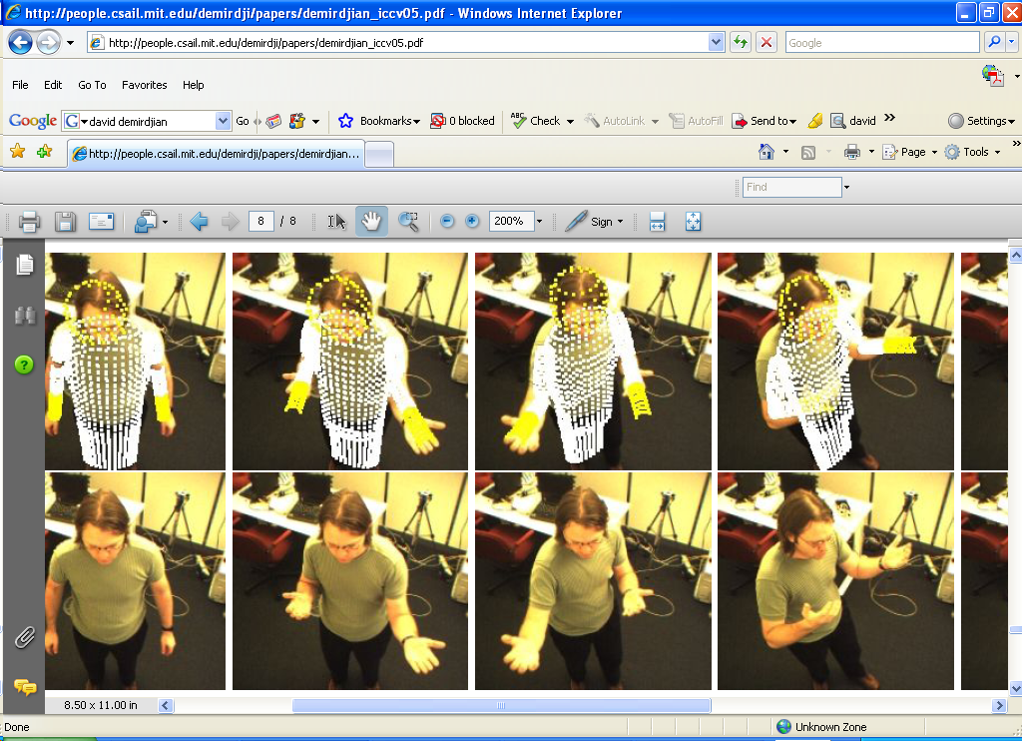
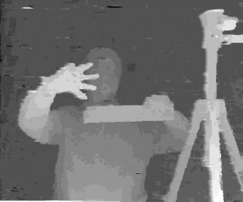
1. Vision for measurement
Real-time stereo
Structure from motion
Tracking
NASA Mars Rover
Snavely et al.
Demirdjian et al.
Wang et al.
Slide credit: Kristen Grauman
Notes:
6

Slide 7
Computer Vision
Automatic understanding of images and video
Computing properties of the 3D world from visual data (measurement)
Algorithms and representations to allow a machine to recognize objects, people, scenes, and activities (perception and interpretation)
Notes:
7

Slide 8
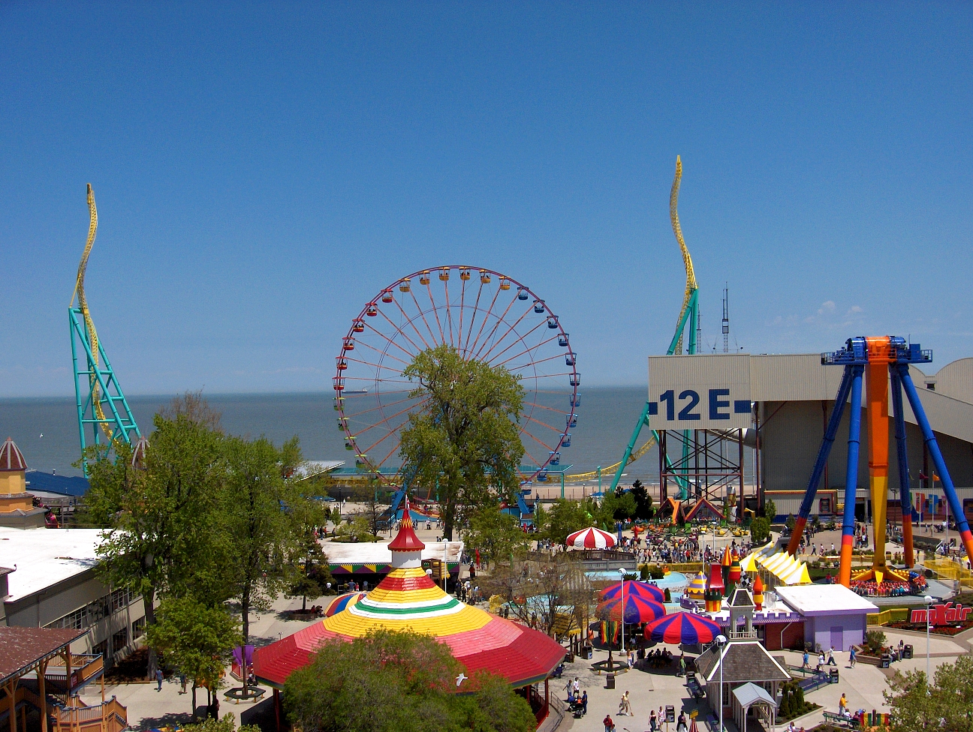
2. Vision for perception, interpretation
amusement park
Objects
Activities
Scenes
Locations
Text / writing
Faces
Gestures
Motions
Emotions…
sky
The Wicked Twister
Cedar Point
ride
Ferris wheel
ride
12 E
Lake Erie
water
ride
tree
tree
people waiting in line
people sitting on ride
umbrellas
tree
maxair
carousel
deck
bench
tree
pedestrians
Slide credit: Kristen Grauman
Notes:
8

Slide 9
Computer Vision
Automatic understanding of images and video
Computing properties of the 3D world from visual data (measurement)
Algorithms and representations to allow a machine to recognize objects, people, scenes, and activities. (perception and interpretation)
Algorithms to mine, search, and interact with visual data (search and organization)
Notes:
9

Slide 10
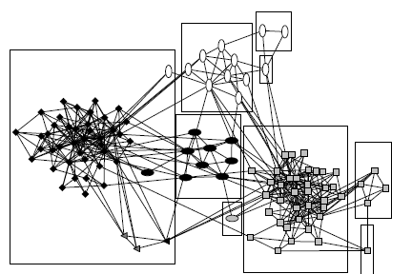
3. Visual search, organization
3
?
2
1
Query
Image or video archives
Relevant content
Slide credit: Kristen Grauman

Slide 11
Related disciplines
Artificial intelligence
Machine learning
Graphics
Computer vision
Image processing
Cognitive science
Algorithms
Slide credit: Kristen Grauman

Slide 12

Vision and graphics
Images
Vision
Model
Graphics
Inverse problems: analysis and synthesis
Slide credit: Kristen Grauman

Slide 13
Why is vision difficult?

Slide 14
What humans see
14

Slide 15
What computers see
243 | 239 | 240 | 225 | 206 | 185 | 188 | 218 | 211 | 206 | 216 | 225
242 | 239 | 218 | 110 | 67 | 31 | 34 | 152 | 213 | 206 | 208 | 221
243 | 242 | 123 | 58 | 94 | 82 | 132 | 77 | 108 | 208 | 208 | 215
235 | 217 | 115 | 212 | 243 | 236 | 247 | 139 | 91 | 209 | 208 | 211
233 | 208 | 131 | 222 | 219 | 226 | 196 | 114 | 74 | 208 | 213 | 214
232 | 217 | 131 | 116 | 77 | 150 | 69 | 56 | 52 | 201 | 228 | 223
232 | 232 | 182 | 186 | 184 | 179 | 159 | 123 | 93 | 232 | 235 | 235
232 | 236 | 201 | 154 | 216 | 133 | 129 | 81 | 175 | 252 | 241 | 240
235 | 238 | 230 | 128 | 172 | 138 | 65 | 63 | 234 | 249 | 241 | 245
237 | 236 | 247 | 143 | 59 | 78 | 10 | 94 | 255 | 248 | 247 | 251
234 | 237 | 245 | 193 | 55 | 33 | 115 | 144 | 213 | 255 | 253 | 251
248 | 245 | 161 | 128 | 149 | 109 | 138 | 65 | 47 | 156 | 239 | 255
190 | 107 | 39 | 102 | 94 | 73 | 114 | 58 | 17 | 7 | 51 | 137
23 | 32 | 33 | 148 | 168 | 203 | 179 | 43 | 27 | 17 | 12 | 8
17 | 26 | 12 | 160 | 255 | 255 | 109 | 22 | 26 | 19 | 35 | 24
Slide credit: Larry Zitnick
15

Slide 16
Why is vision difficult?
Ill-posed problem: real world much more complex than what we can measure in images
3D → 2D
Impossible to literally “invert” image formation process
Slide credit: Kristen Grauman

Slide 17
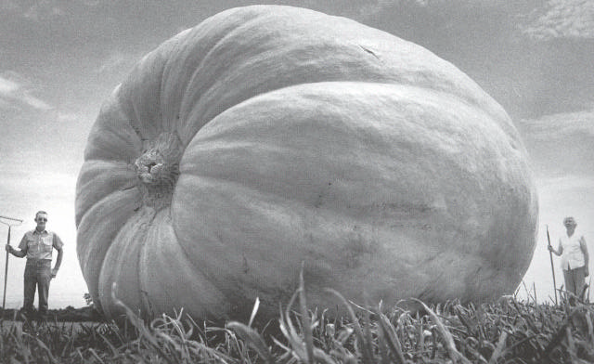
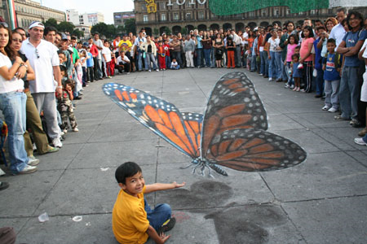
Challenges: ambiguity
Many different 3D scenes could have given rise to a particular 2D picture
Slide credit: Svetlana Lazebnik

Slide 18
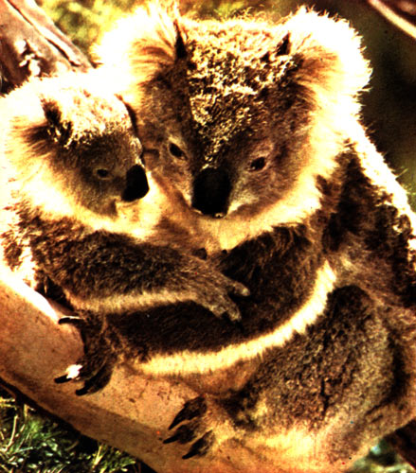
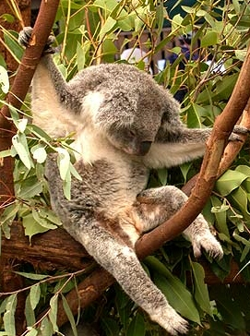
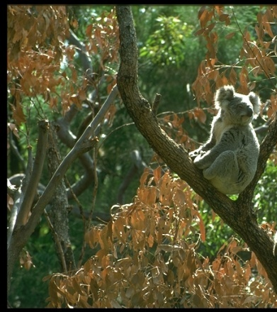


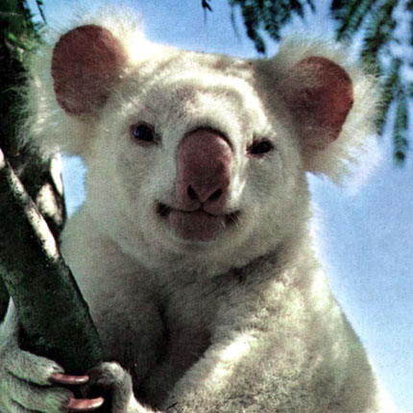
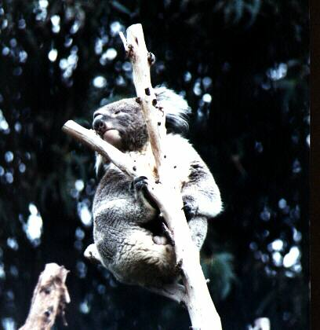
Challenges: many nuisance parameters
Illumination
Object pose
Clutter
Occlusions
Intra-class appearance
Viewpoint
Slide credit: Kristen Grauman

Slide 19
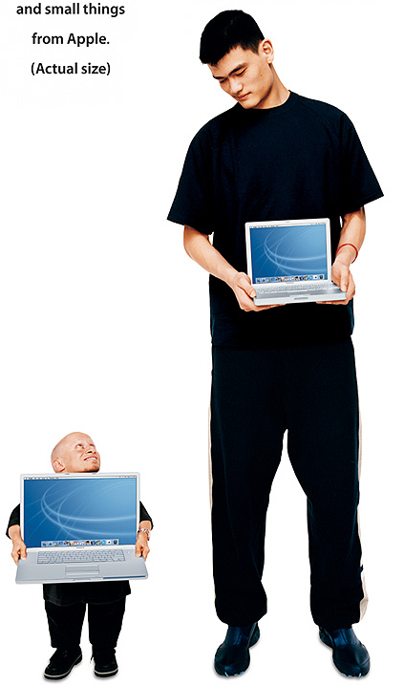
Challenges: scale
slide credit: Fei-Fei, Fergus, Torralba

Slide 20
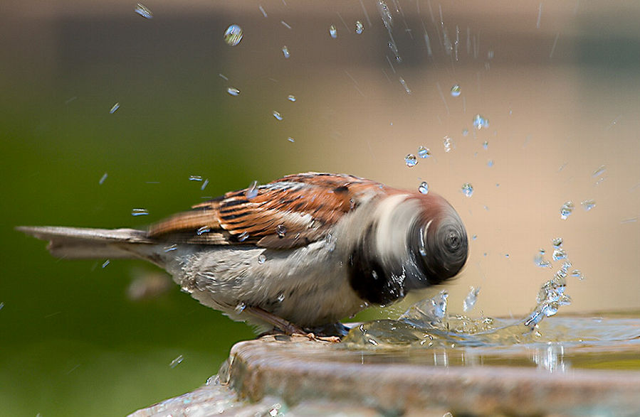
Challenges: Motion
slide credit: Svetlana Lazebnik

Slide 21
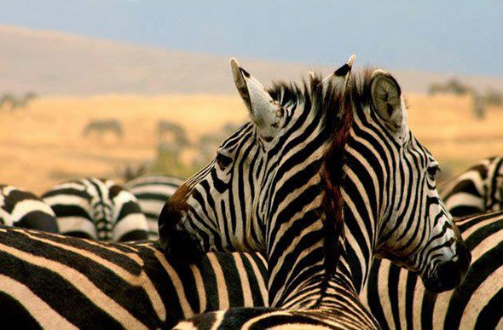
Challenges: occlusion, clutter
Image source: National Geographic
slide credit: Svetlana Lazebnik

Slide 22
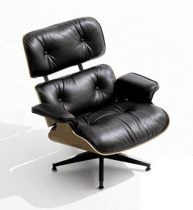
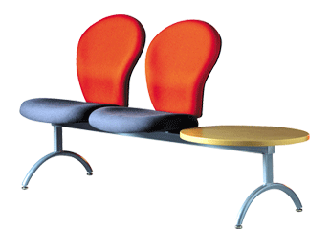
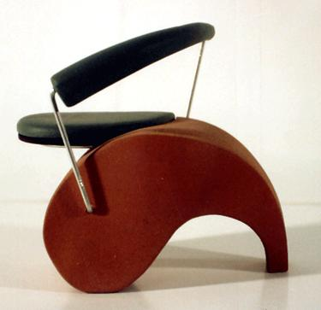
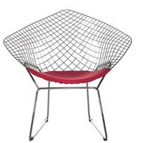
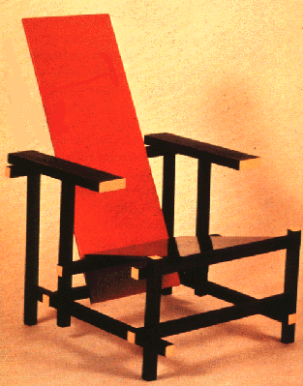
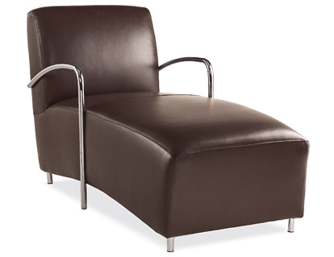
Challenges: object intra-class variation
slide credit: Fei-Fei, Fergus, Torralba

Slide 23


Challenges: context and human experience
Slide credit: Fei-Fei, Fergus, Torralba

Slide 24

Challenges: context and human experience
Fei Fei Li, Rob Fergus, Antonio Torralba

Slide 25
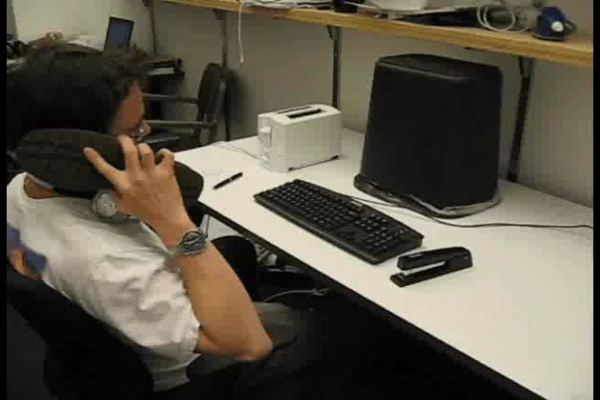
Challenges: context and human experience
Fei Fei Li, Rob Fergus, Antonio Torralba

Slide 26
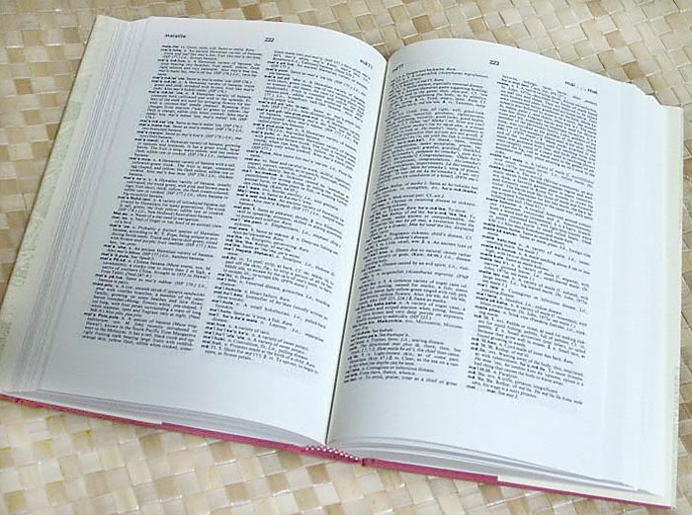

How many object categories are there?
Challenges: complexity
~10,000 to 30,000
Biederman 1987
Slide credit: Fei-Fei, Fergus, Torralba

Slide 27






Challenges: complexity
10 billion images
250 billion images
1 billion images served daily
10 billion images
100 hours uploaded per minute
From
:
Almost 90% of web traffic is visual!

Slide 28
Challenges: complexity
Thousands to millions of pixels in an image
30+ degrees of freedom in the pose of articulated objects (humans)
About half of the cerebral cortex in primates is devoted to processing visual information [Felleman and van Essen 1991]
Slide credit: Kristen Grauman

Slide 29
What works well today?

Slide 30

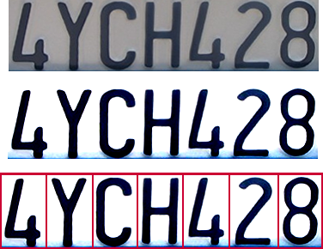
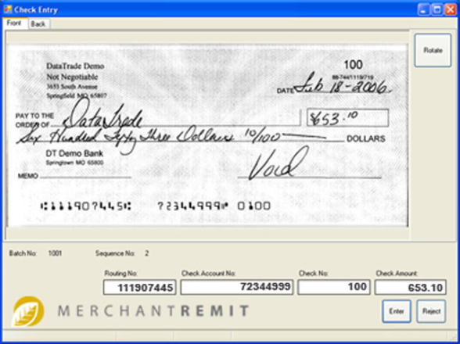
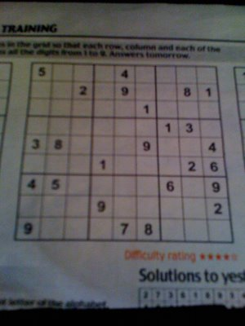
Optical character recognition (OCR)
Digit recognition yann.lecun.com
License plate readers http://en.wikipedia.org/wiki/Automatic_number_plate_recognition
Sudoku grabber
http://sudokugrab.blogspot.com/
Automatic check processing
Source: S. Seitz, N. Snavely

Slide 31
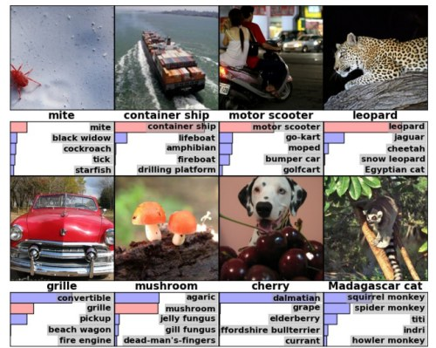
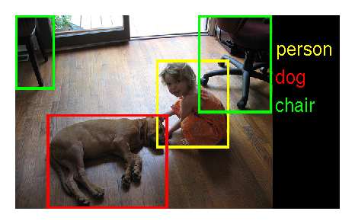
Image classification and object detection
Object detection
Image classification

Slide 32
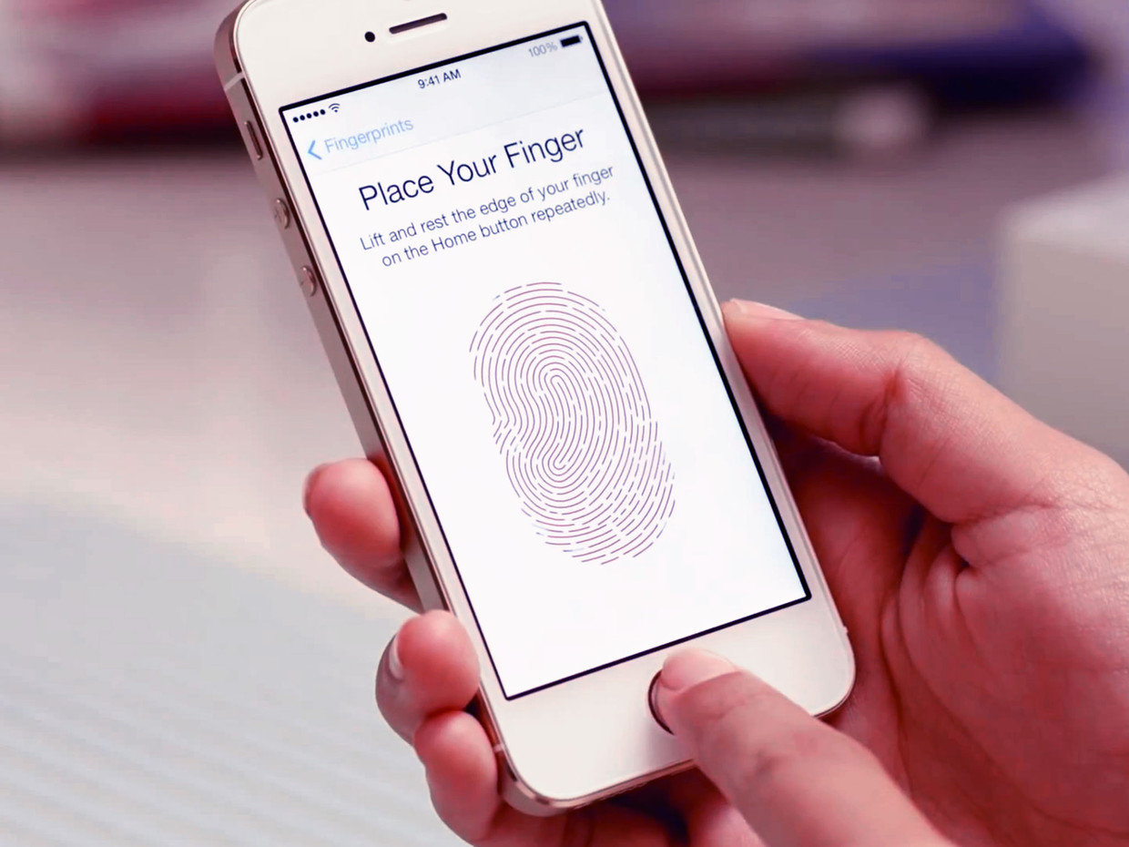
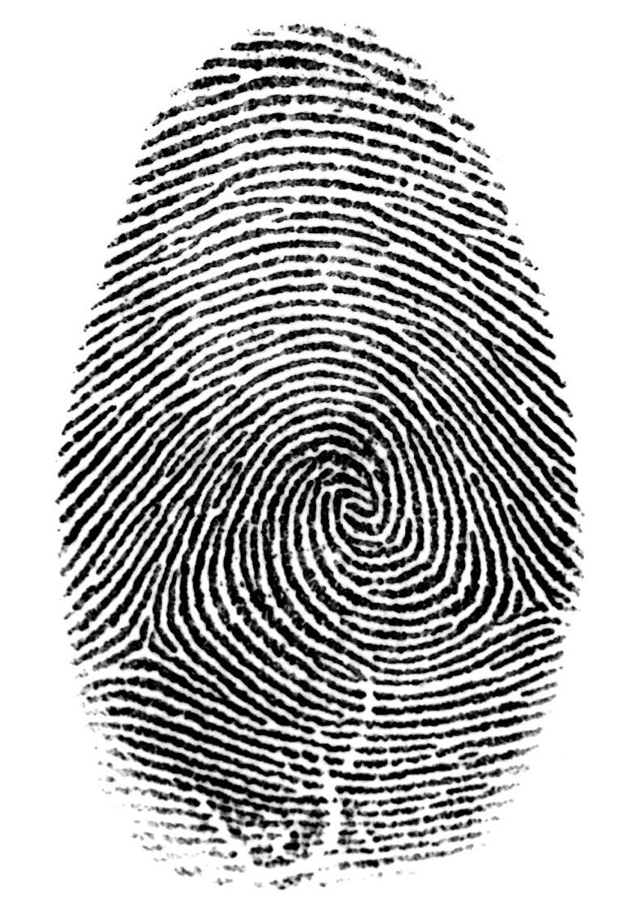
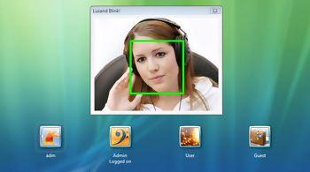
Biometrics
Face recognition systems
Fingerprint scanners

Slide 33
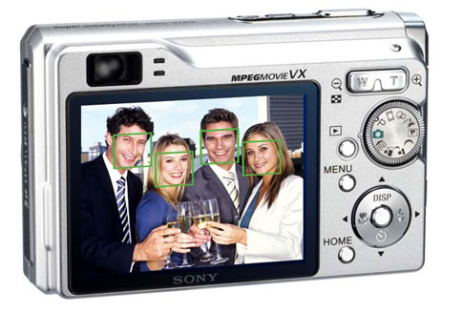
Face detection
Source: S. Seitz
Notes:
Why would this be useful? Main reason is focus. Also enables “smart” cropping.

Slide 34
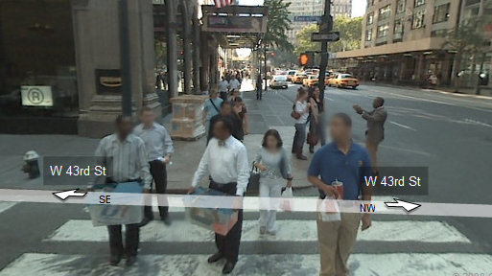

Face detection for privacy protection
slide credit: Svetlana Lazebnik

Slide 35
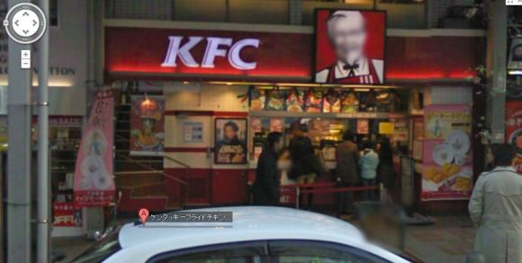
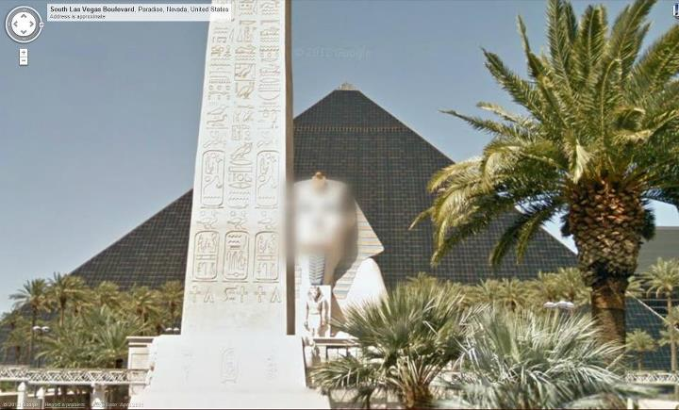
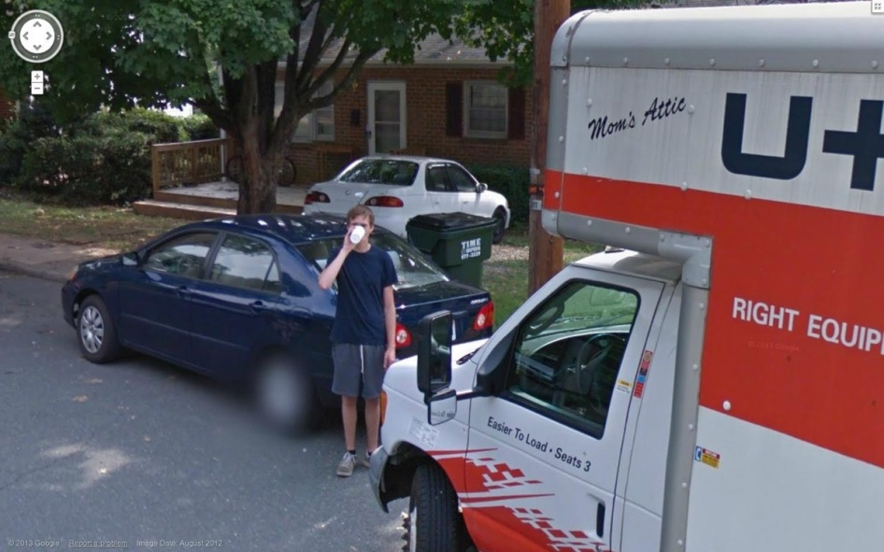
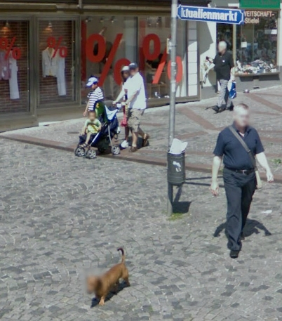
Technology gone wild…
slide credit: Svetlana Lazebnik

Slide 36
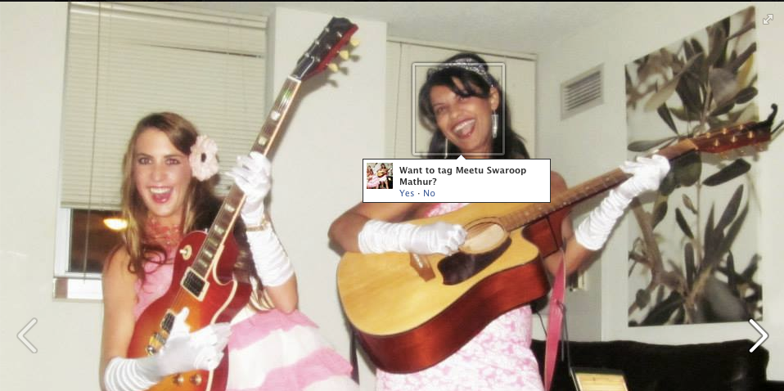

Face recognition
Slide credit: Devi Parikh

Slide 37
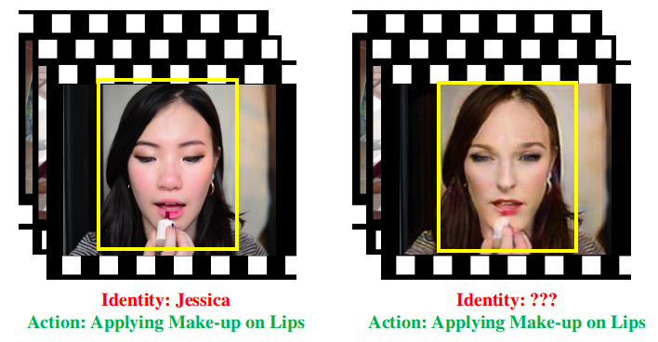
Face anonymization
Zhongzheng Ren, Yong Jae Lee, and Michael Ryoo.
Learning to Anonymize Faces for Privacy Preserving Action Detection. arXiv 2018.

Slide 38
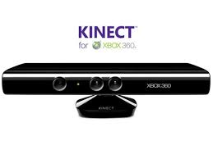
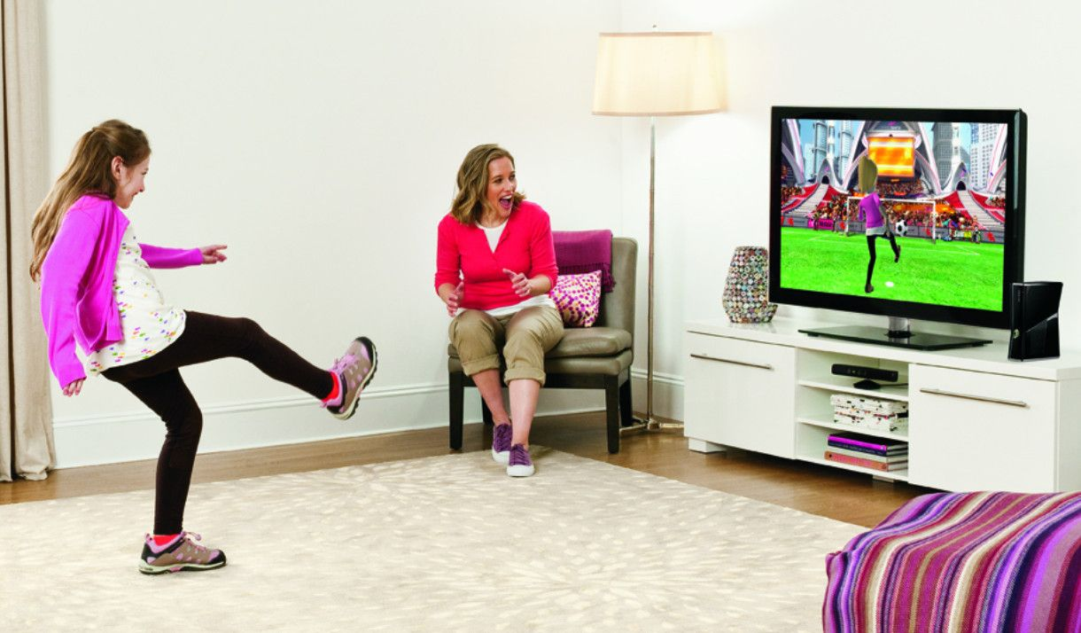
Interactive systems
Shotton et al.

Slide 39
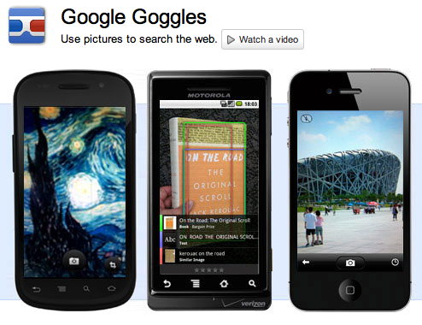
Instance recognition
Slide credit: Devi Parikh

Slide 40
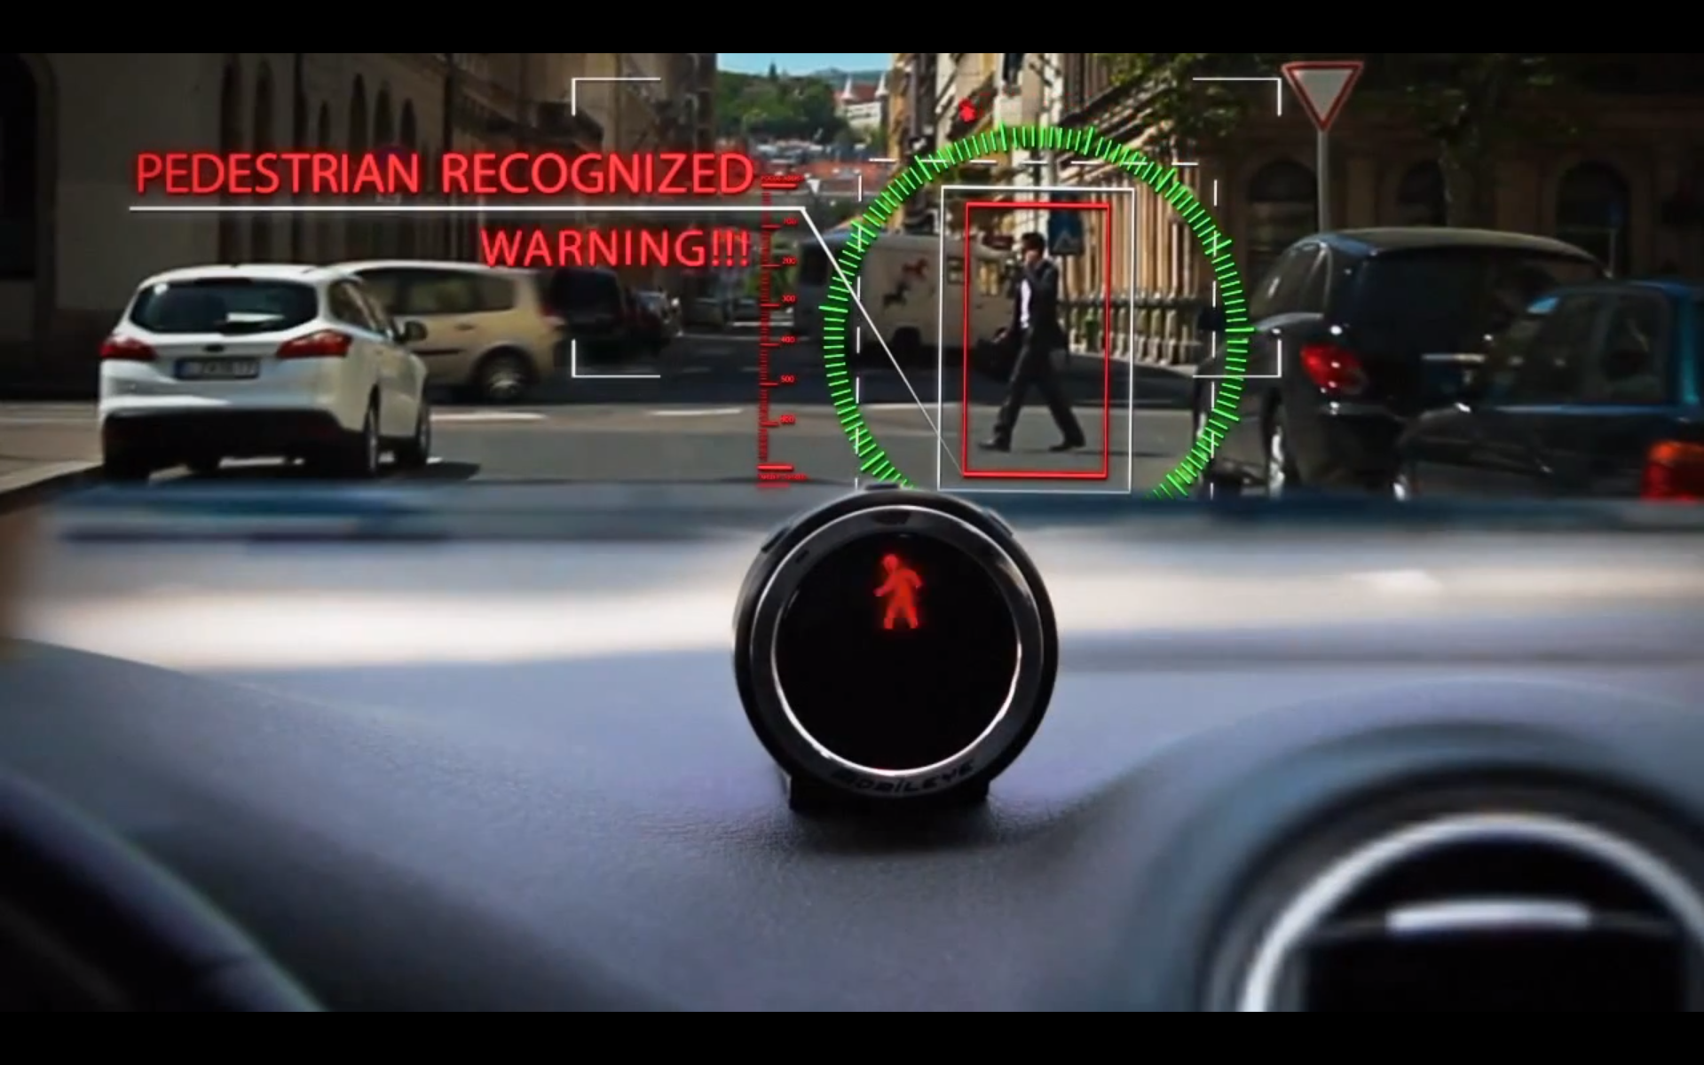
Pedestrian detection
Slide credit: Devi Parikh

Slide 41
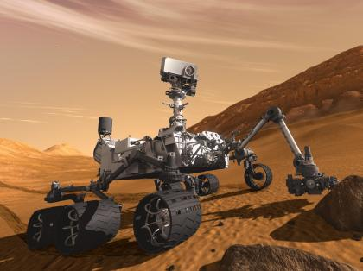
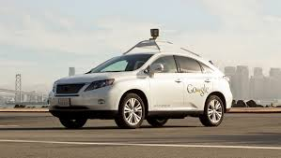
Autonomous agents
Mars rover
Self-driving car

Slide 42
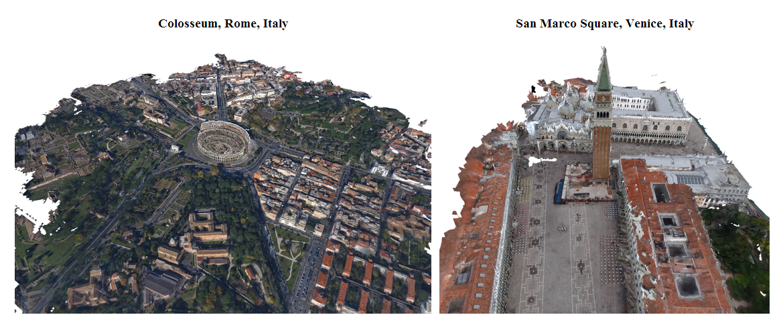
3D reconstruction from photo collections
Q. Shan, R. Adams, B. Curless, Y. Furukawa, and S. Seitz, The Visual Turing Test for Scene Reconstruction, 3DV 2013
slide credit: Svetlana Lazebnik

Slide 43
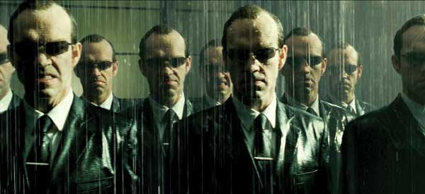

Special effects: shape capture
The Matrix movies, ESC Entertainment, XYZRGB, NRC
Source: S. Seitz

Slide 44


Special effects: motion capture
Pirates of the Carribean, Industrial Light and Magic
Source: S. Seitz

Slide 45


Medical imaging
3D imaging
MRI, CT
Image guided surgery
Grimson et al., MIT
Source: S. Seitz

Slide 46

Visual data in 1963
L. G. Roberts, Machine Perception of Three Dimensional Solids, Ph.D. thesis, MIT Department of Electrical Engineering, 1963.
Slide credit: Kristen Grauman

Slide 47
































Visual data today
Understand and organize and index all this data!!
Personal photo albums
Movies, news, sports
Surveillance and security
Medical and scientific images
Svetlana Lazebnik
Notes:
47

Slide 48
Why vision?
As image sources multiply, so do applications
Relieve humans of boring, easy tasks
Enhance human abilities
Advance human-computer interaction, visualization
Perception for robotics / autonomous agents
Organize and give access to visual content
Slide credit: Kristen Grauman

Slide 49
Applications
Law enforcement / Surveillance
Robotics
Autonomous driving
Medical imaging
Photo organization
Image search
E-commerce
… cell phone cameras, social media, Google Glass, etc.
Slide adapted from Devi Parikh

Slide 50


Summary
Computer Vision is useful, interesting, and difficult
A growing and exciting field
Lots of cool and important applications
New teams in existing companies, startups, etc.

Slide 51
Introductions
Instructor
Yong Jae Lee
yongjaelee@ucdavis.edu
Assistant Professor in CS, UC Davis since July 2014
Research areas: Computer vision and machine learning
Visual Recognition
Graphics Applications

Slide 52


Introductions
TAs:
Chongruo Wu
crwu@ucdavis.edu
PhD student in CS
Maheen Rashid
mhnrashid@ucdavis.edu
PhD student in CS

Slide 53
This course
ECS 174 (4-units)
Lecture: Tues & Thurs 12:10-1:30 pm, Giedt Hall 1002
Discussion section: Mon 5:10-6pm, Chem 179 (location may change)
Office hours: Academic Surge 1044/2075
Maheen: Tues 10 am-noon (AS 1044)
Chongruo: Thurs 3-5 pm (AS 1044)
Yong Jae: Fri 3-5 pm (AS 2075)
Notes:
53
Google me → My homepage → Teaching

Slide 54
This course
Course webpage
https://sites.google.com/a/ucdavis.edu/ecs-174-computer-vision---spring-2018/
Canvas (assignment submission, grades)
https://canvas.ucdavis.edu/courses/225624
Piazza
piazza.com/uc_davis/spring2018/ecs174/
Notes:
54
Google me → My homepage → Teaching

Slide 55
Goals of this course
Introduction to primary topics in Computer Vision
Basics and fundamentals
Practical experience through assignments
Views of computer vision as a research area
Notes:
55

Slide 56
Prerequisites
Upper-division undergrad course
Basic knowledge of probability and linear algebra
Data structures, algorithms
Programming experience
Experience with image processing or Matlab will help but is not necessary
Notes:
56

Slide 57
Topics overview
Features and filters
Grouping and fitting
Recognition and learning
Focus is on algorithms, rather than specific systems

Slide 58








Features and filters
Transforming and describing images; textures, edges
Slide credit: Kristen Grauman

Slide 59




Grouping and fitting
Clustering, segmentation, fitting; what parts belong together?
[fig from Shi et al]
Slide credit: Kristen Grauman

Slide 60





Recognition and learning
Recognizing objects and categories, learning techniques
Slide credit: Kristen Grauman

Slide 61


Recognition and learning
Deep learning

Slide 62



Not covered: Multiple views and motion
Multi-view geometry, stereo vision
Lowe
Hartley and Zisserman
Fei-Fei Li
Slide credit: Kristen Grauman

Slide 63



Not covered: Video processing
Tracking objects, video analysis, low level motion, optical flow
Tomas Izo
Slide credit: Kristen Grauman

Slide 64


Textbooks
By Rick Szeliski
http://szeliski.org/Book/
By Kristen Grauman, Bastian Leibe
Visual Object Recognition
Notes:
Lectures will be posted online

Slide 65
Requirements / Grading
Problem sets (60%)
Final exam (35%)
comprehensive (cover all topics learned in class)
Class and Piazza participation, including attendance (5%)
Piazza: participation points for posting (sensible) questions and answers

Slide 66
Problem sets
Some short answer concept questions
Matlab programming problems
Implementation
Explanation, results
Follow instructions; points will be deducted if we can’t run your code out of the box
Ask questions on Piazza first
Submit to Canvas
The assignments will take significant time to do
Start early
TA will go over problem set during discussion sections after release (others will be used as extra office hours)

Slide 67

Matlab
Built-in toolboxes for low-level image processing, visualization
Compact programs
Intuitive interactive debugging
Widely used in engineering
Slide credit: Kristen Grauman

Slide 68
Matlab
CSIF labs 67, 71, 75 (pc1-pc60)
Academic Surge 1044 and 1116
Lab schedule (reservations) and remote access info found on class website
Matlab available for free from campus software site

Slide 69
Problem Set 0
Matlab warmup
Basic image manipulation
Out Thursday, due 4/13

Slide 70




Preview of some problem sets
resize: castle squished
crop: castle cropped
content aware resizing:
seam carving

Slide 71


Preview of some problem sets
Grouping

Slide 72




Preview of some problem sets
Object search and recognition
Notes:
72

Slide 73
Problem set deadlines
Problem sets due 11:59 PM
Follow submission instructions given in assignment
Submit to Canvas; no hard copy submissions
Deadlines are firm. We’ll use Canvas timestamp. Even 1 minute late is late.
Late submissions: 1 point deduction for every hour after the deadline up to 72 hours; after 72 hours, you will receive a 0
If your program doesn’t work, clean up the code, comment it well, explain what you have, and still submit. Draw our attention to this in your answer sheet.

Slide 74
Collaboration policy
All responses and code must be written individually or in pairs (a group of 2)
Students submitting answers or code found to be identical or substantially similar (due to inappropriate collaboration) risk failing the course
We will be using MOSS to check for cheating!
Copying online solutions also counts as cheating!
Please don’t cheat… you are going to get caught!
Read and follow UC Davis code of conduct

Slide 75

MOSS

Slide 76
Miscellaneous
Check class website regularly for assignment files, notes, announcements, etc.
Come to lecture on time
No laptops, phones, tablets, etc. in class please
Please interrupt with questions at any time

Slide 77
Coming up
Read the class webpage carefully
Next class (Thurs): lecture on linear filters
PS0 out Thursday, due 4/13

Slide 78
Questions?
See you Thursday!

